Slide 1

Sales Department

Slide 2
Objectives
Evaluate sales
Determine ways to improve sales

Slide 3
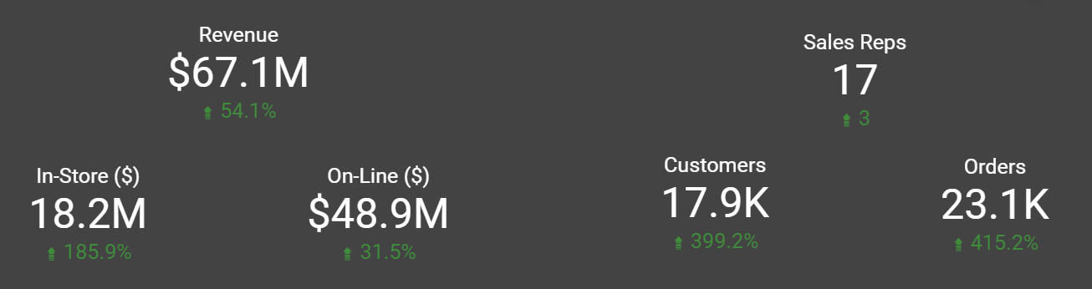
How are we doing?

Slide 4
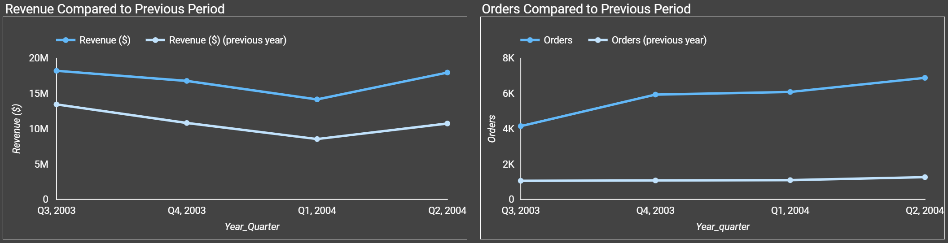
Is there continuous growth?

Slide 5
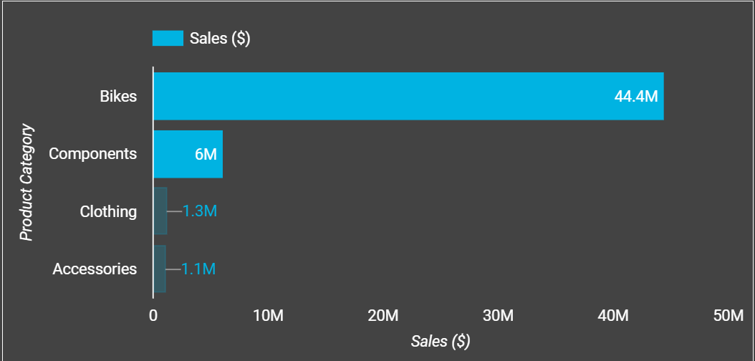
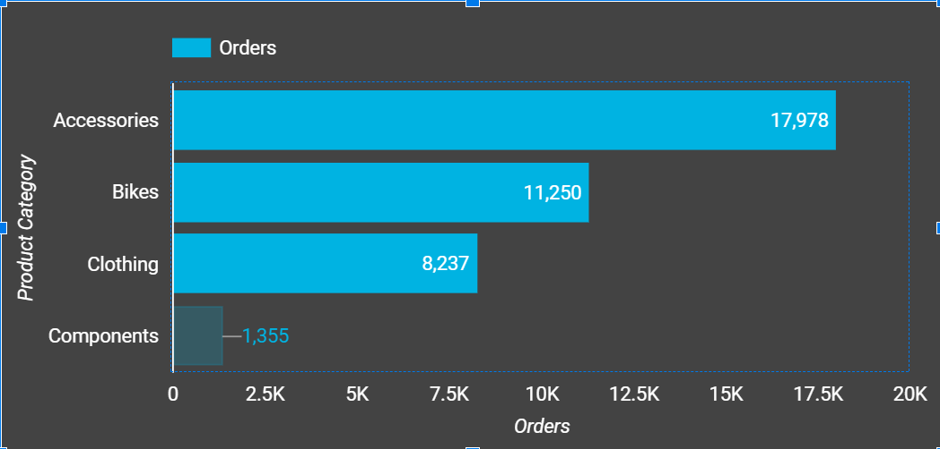
Let’s look at the product categories
Sales and Orders by Product Category

Slide 6
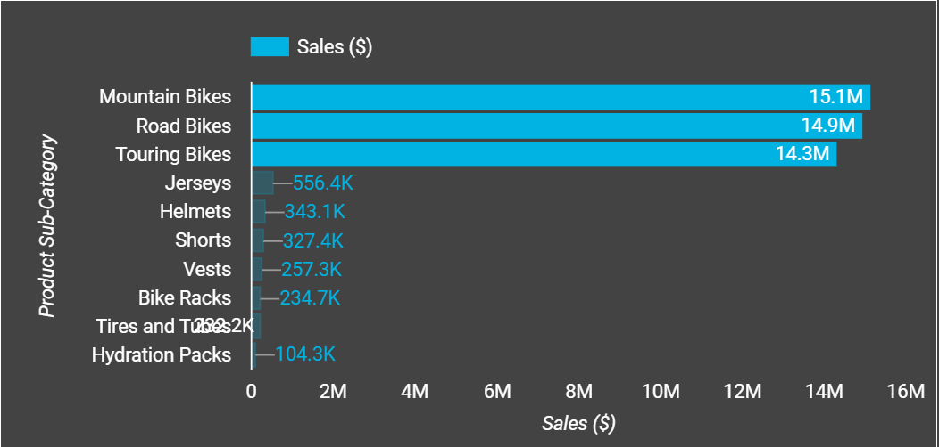
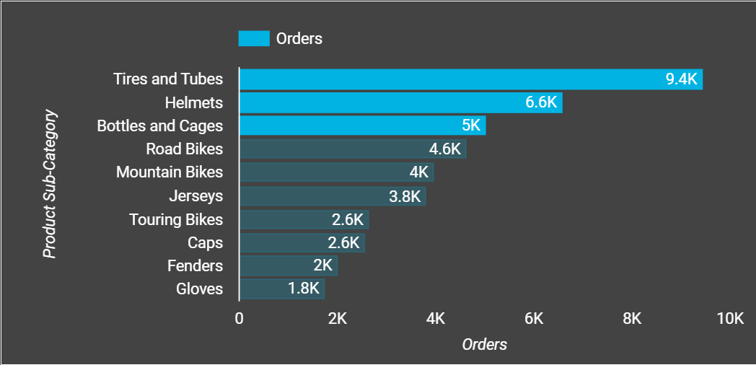
What are the top product categories?
Sales and Orders by Product Category

Slide 7
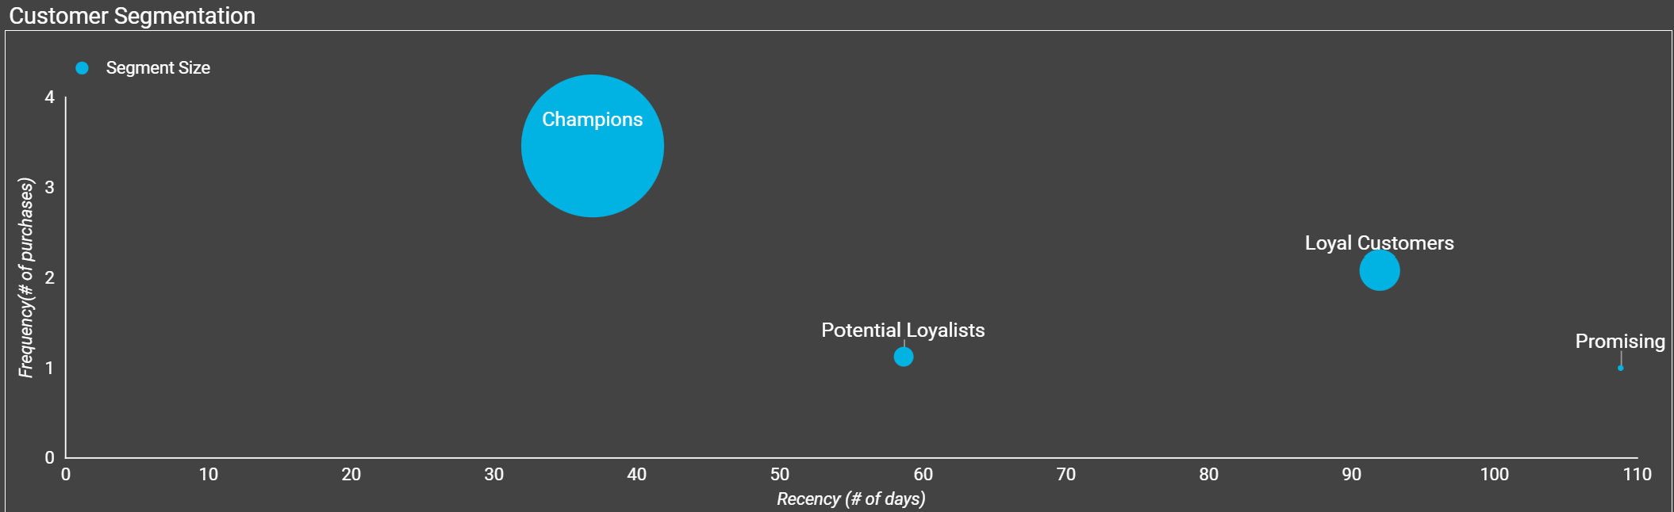
Super customers!
50.2% of customers
$109.6M in Sales

Slide 8
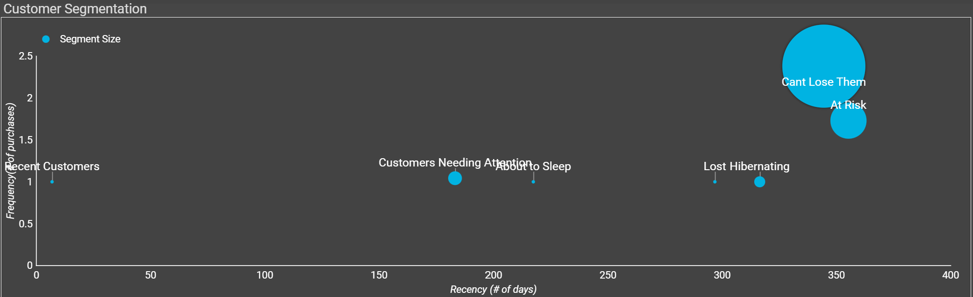
Looking good, right? Well…
49.8% of customers
$77.3M in Sales

Slide 9
Recommendations
Further analysis of product categories and pricing
Reach out to existing customers about continuing business
Marketing campaigns tailored to each customer segment

